Slide 1
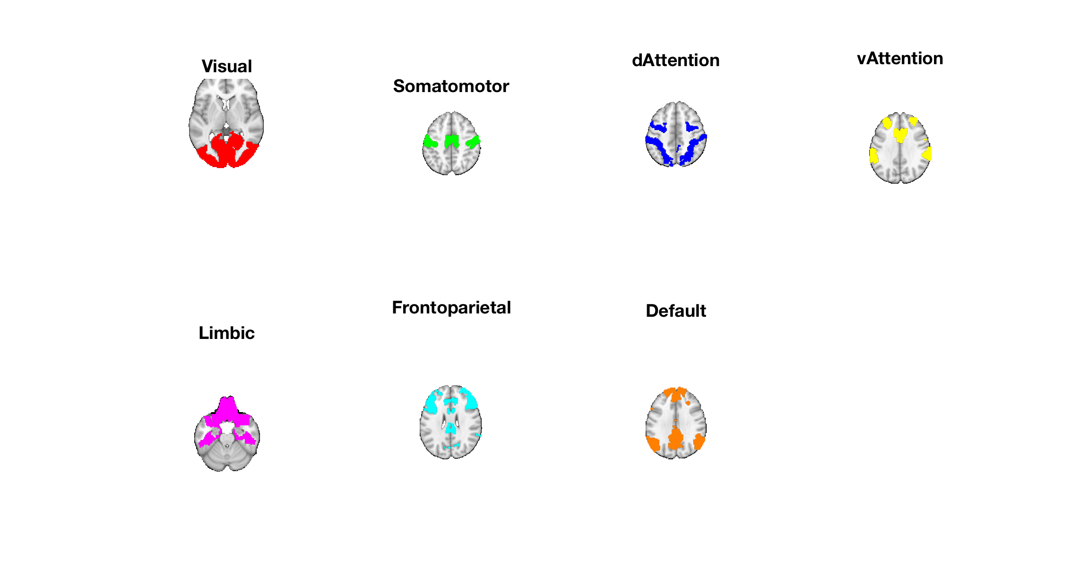
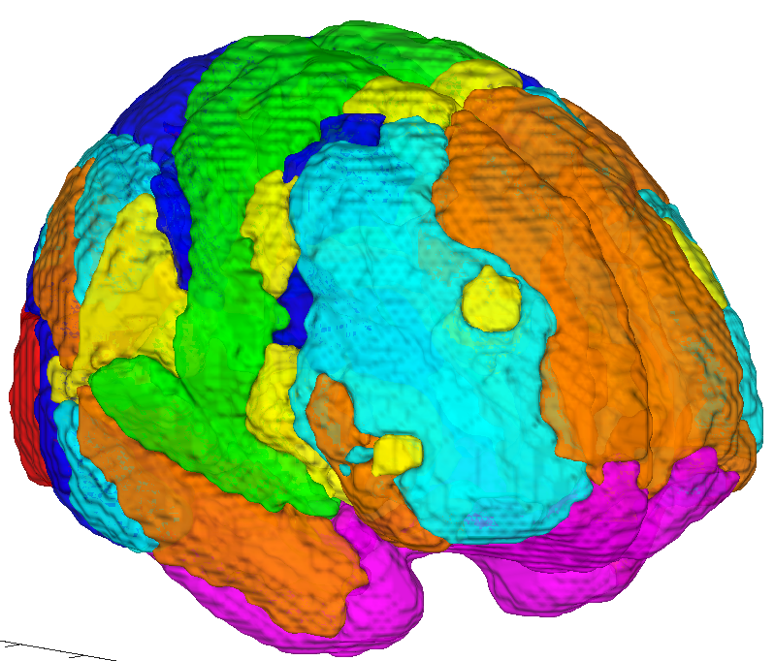
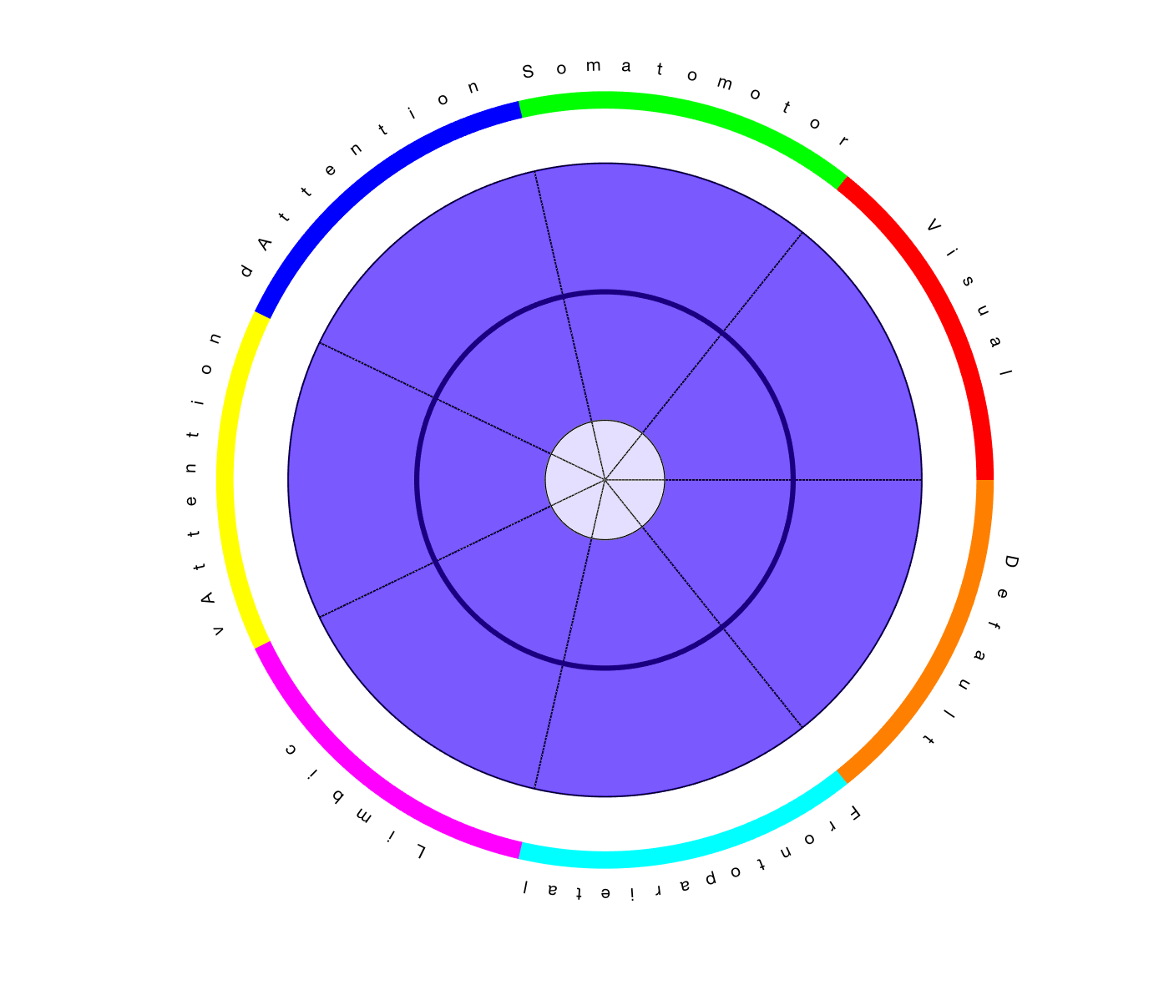
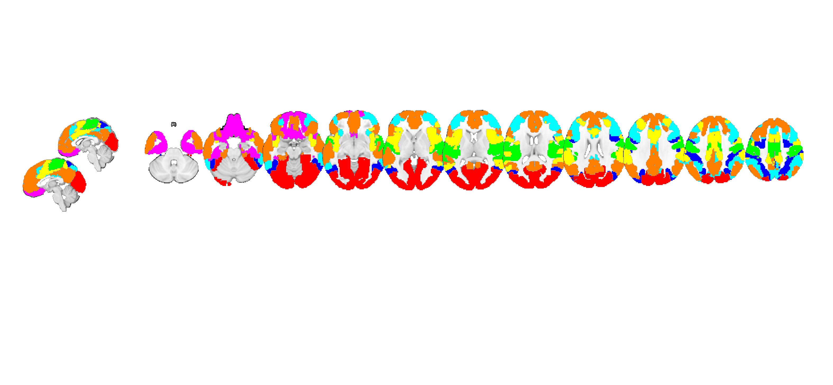
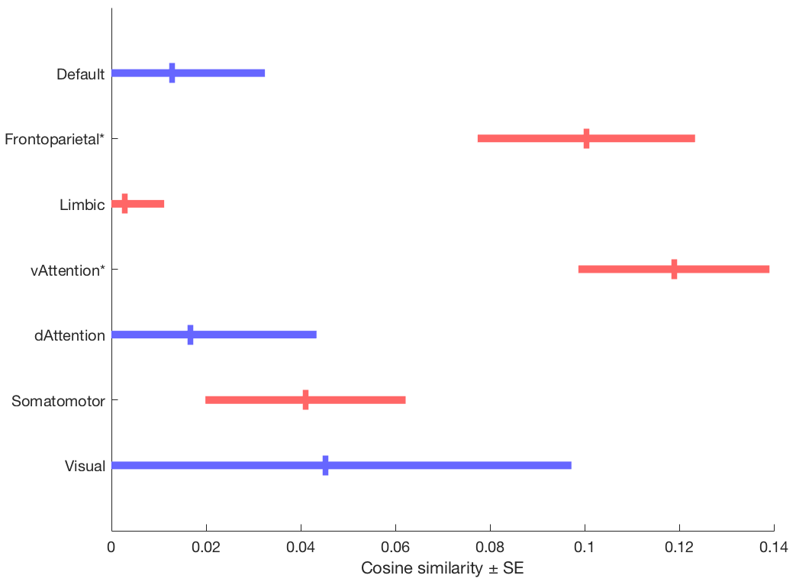
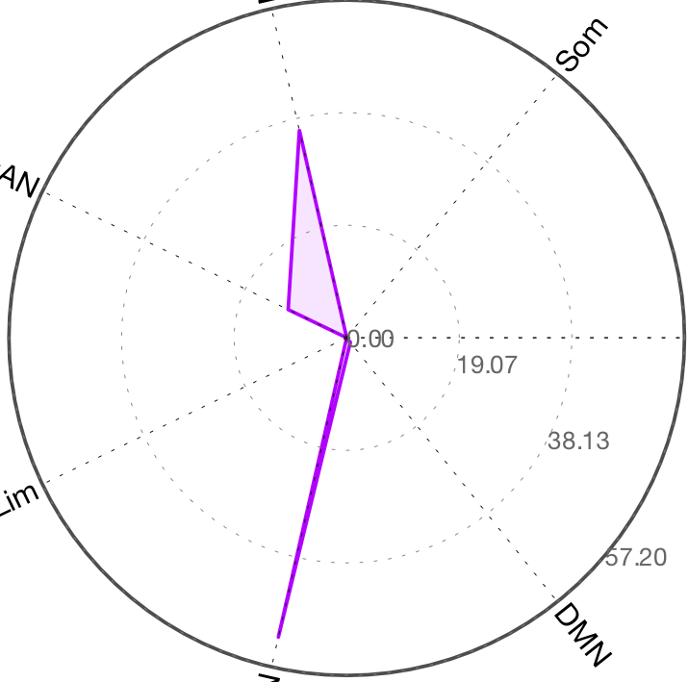
dAttn
SomMot
SomMot
dAttn
Vis
Vis
vAttn
vAttn
Cortical Networks
Wedge plot version
DMN
DMN
Limbic
Limbic
FPN
FPN
dAttn
SomMot
vAttn
Polar plot version
Vis
Cortical Networks
Limbic
DMN
FPN

Slide 2
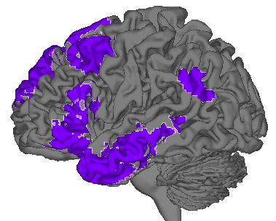
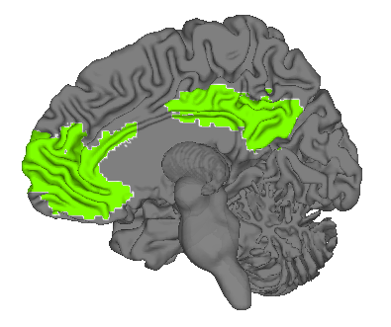
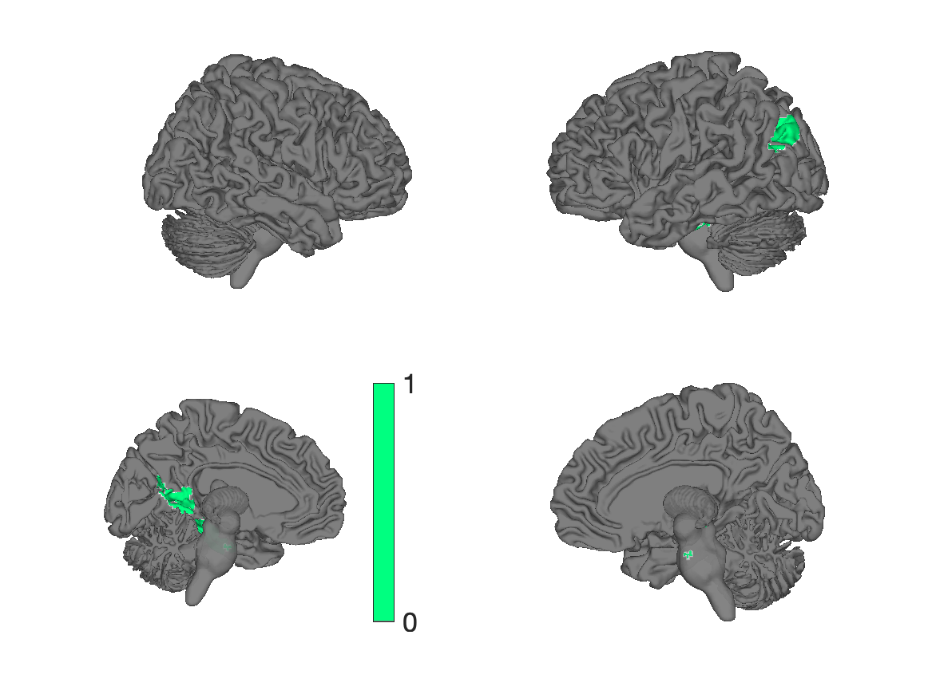
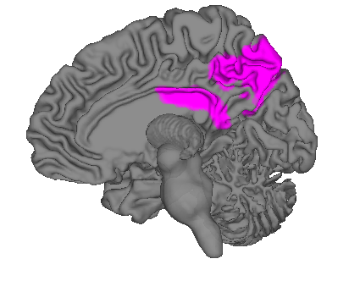
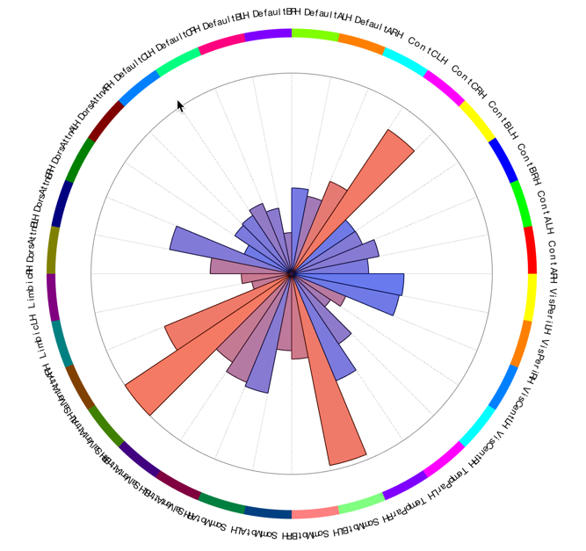
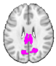
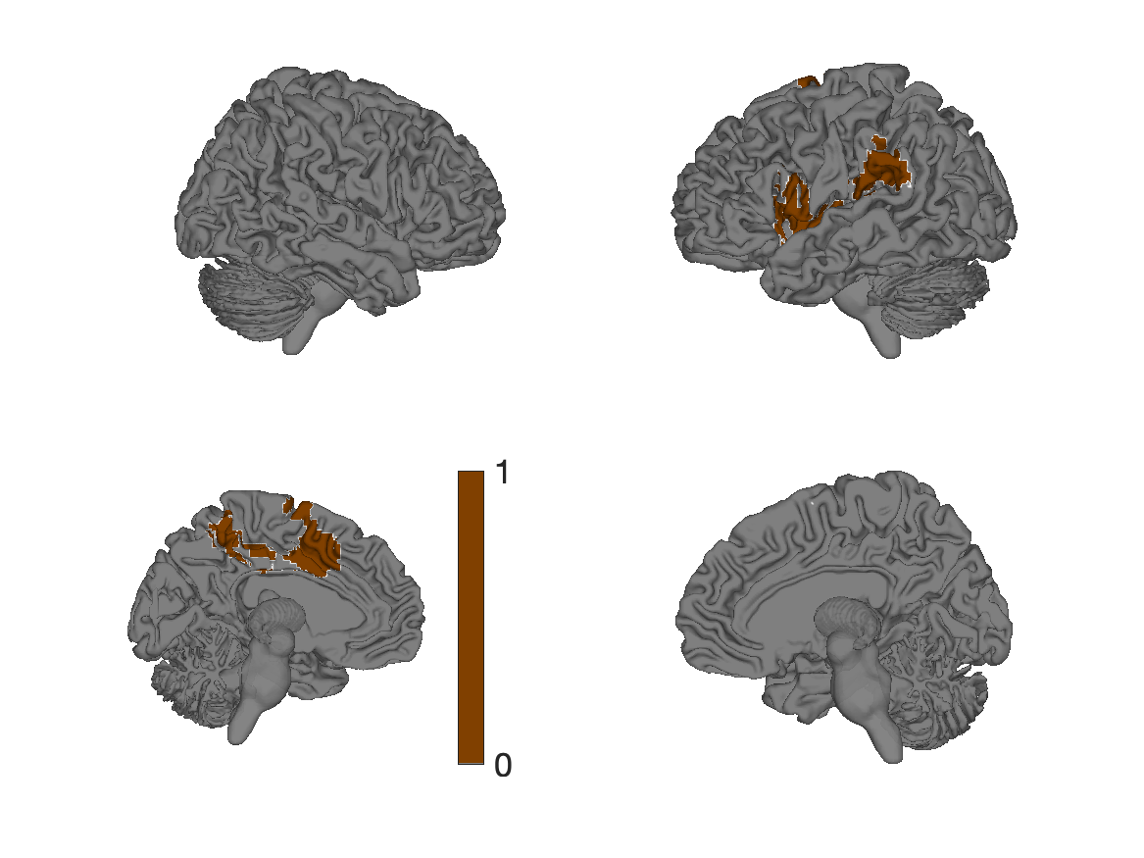
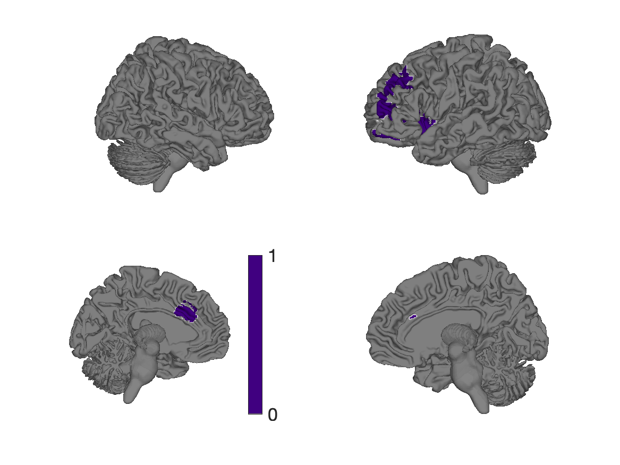
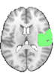
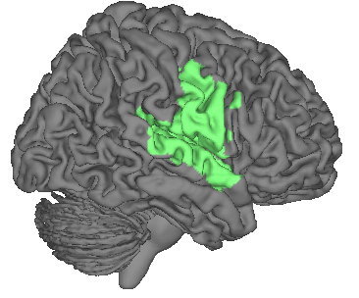
Yeo 17 networks R/L
Default C
Default B
R
L
R
L
Control C
L
R
R
L
dAttn B
Default A
Control B
R
R
L
L
Control C
R
R
dAttn A
Control A
L
L
R
R
Limbic
L
VisPeri B
L
R
R
vAttn A
L
L
VisCent A
R
SomMotor B
R
L
R
L
vAttn B
L
TempPar
R
SomMotor A
L
vAttn A
SomMotor B

Slide 3
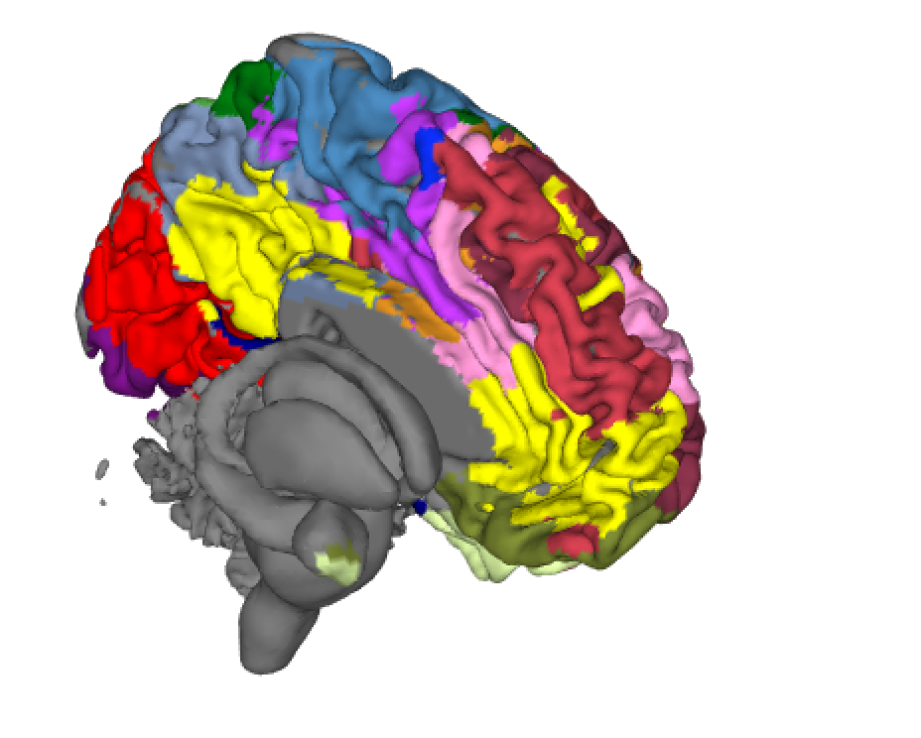
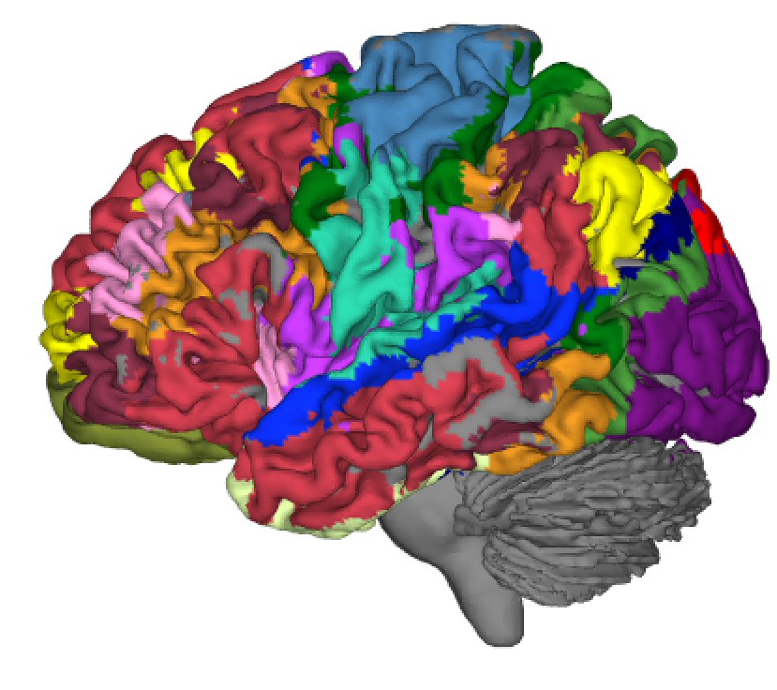
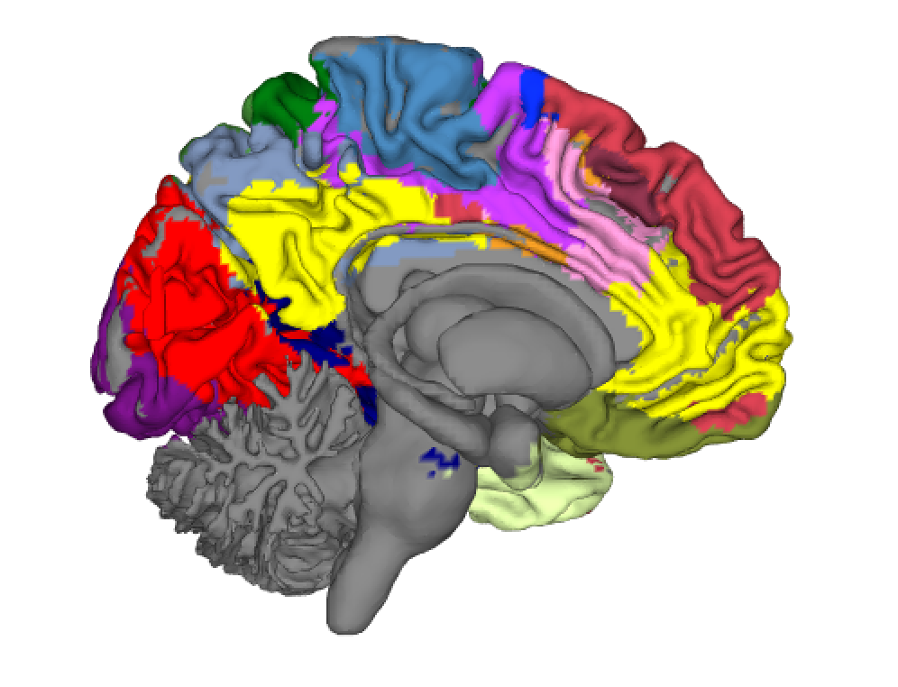
Figure 5
a
c
Networks from 1,000-person functional connectivity
d
e
b
Correlation
Time
Yeo 17 networks

Slide 4
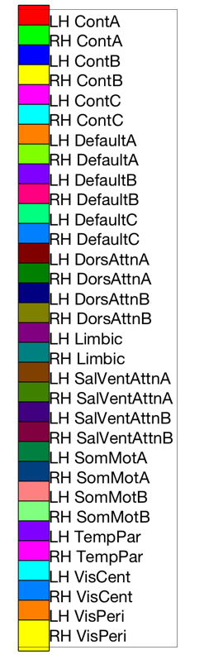
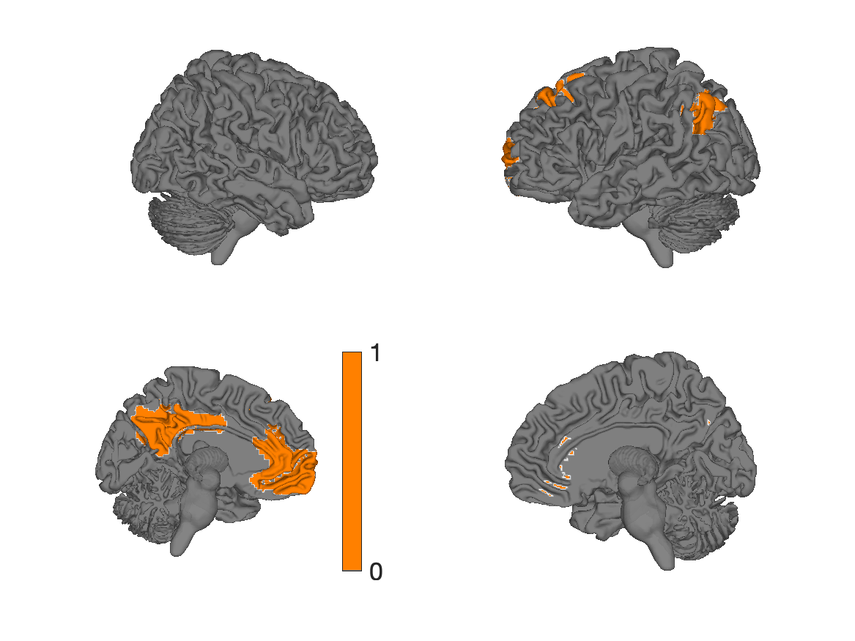
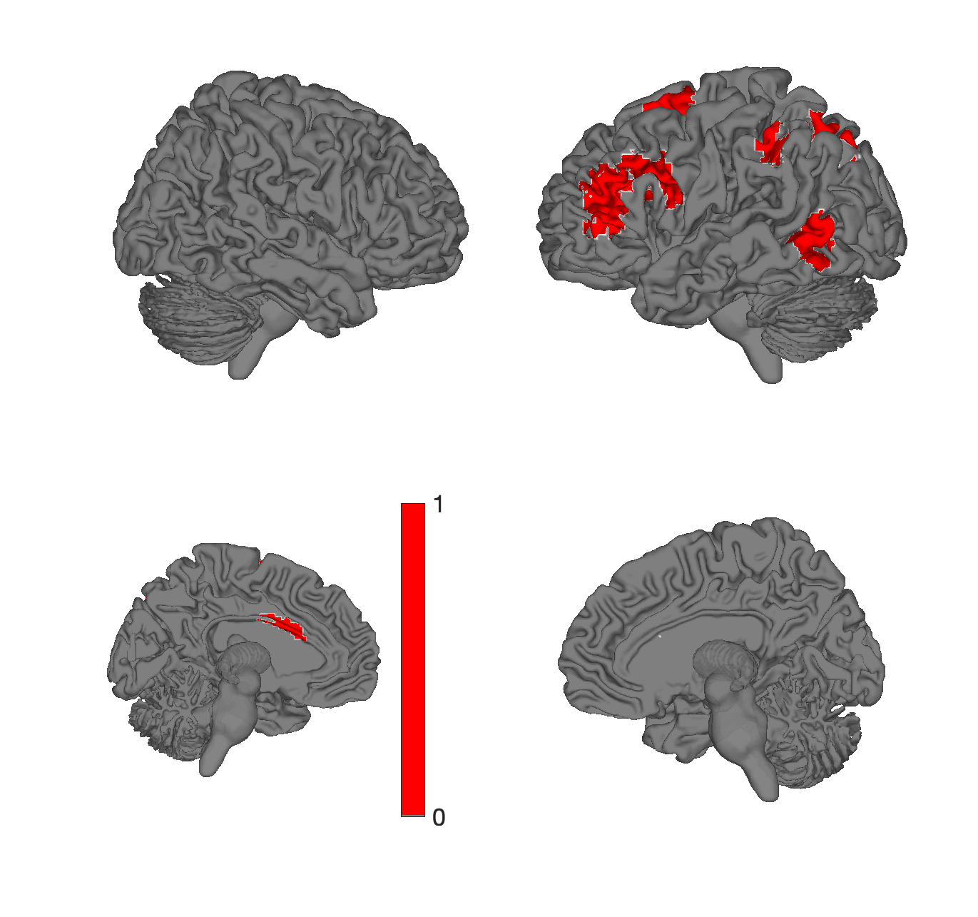
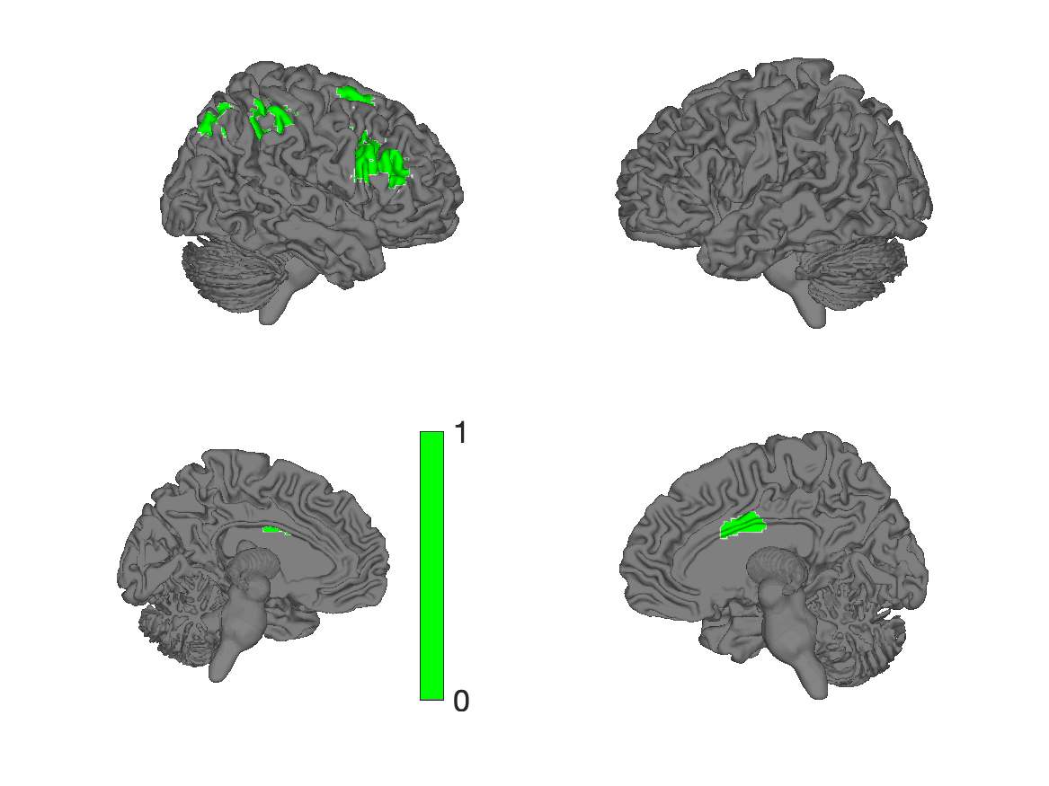
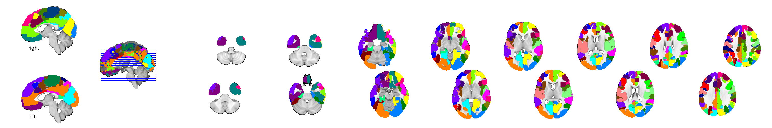
Yeo 17 networks R/L
Default C
Default A
Default B
R
L
R
L
Control C
L
R
R
L
dAttn B
Default A
Control B
R
R
L
L
Control A
R
R
dAttn A
Control A
L
L
R
R
Limbic
L
VisPeri B
L
R
R
vAttn A
L
L
VisCent A
R
SomMotor B
R
L
R
L
vAttn B
L
TempPar
R
SomMotor A
L

Slide 5
Yeo 17 networks R/L
Default C
Default B
L
R
L
R
Control C
R
L
L
R
dAttn B
Default A
Control B
L
L
R
R
L
L
dAttn A
Control A
R
R
L
L
Limbic
R
VisPeri B
R
L
L
vAttn A
R
R
VisCent A
L
SomMotor B
L
R
L
R
vAttn B
R
TempPar
L
SomMotor A
R
Notes:
atl = load_atlas('yeo17networks');
colorband_colors = scn_standard_colors(num_regions(atl));
for i = 29:32 % 1:length(atl.labels)
atl_subset = select_atlas_subset(atl, i);
sh = surface(atl_subset, 'color', colorband_colors{i}, 'foursurfaces');
drawnow
saveas(gcf, ['yeo17networks_4surf' num2str(i) '.png']);
close
sh = surface(atl_subset, 'color', colorband_colors{i});
drawnow
saveas(gcf, ['yeo17networks_cutaway' num2str(i) '.png']);
close
end
diary('network_labels_1-17.txt');
char(atl.labels{:})
diary off
montage(atlas_obj, 'colors', colorband_colors);

Slide 6
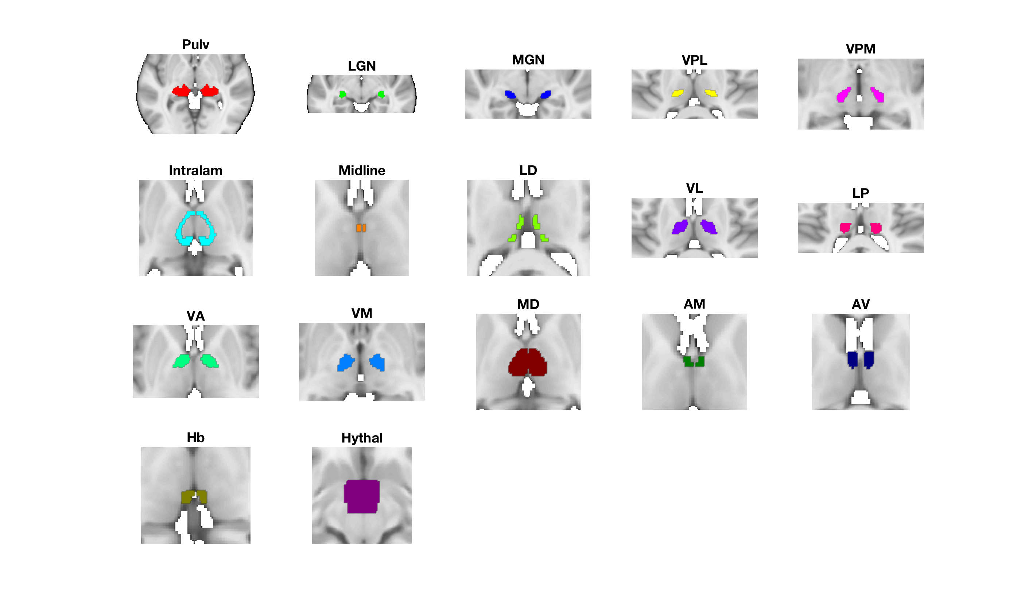
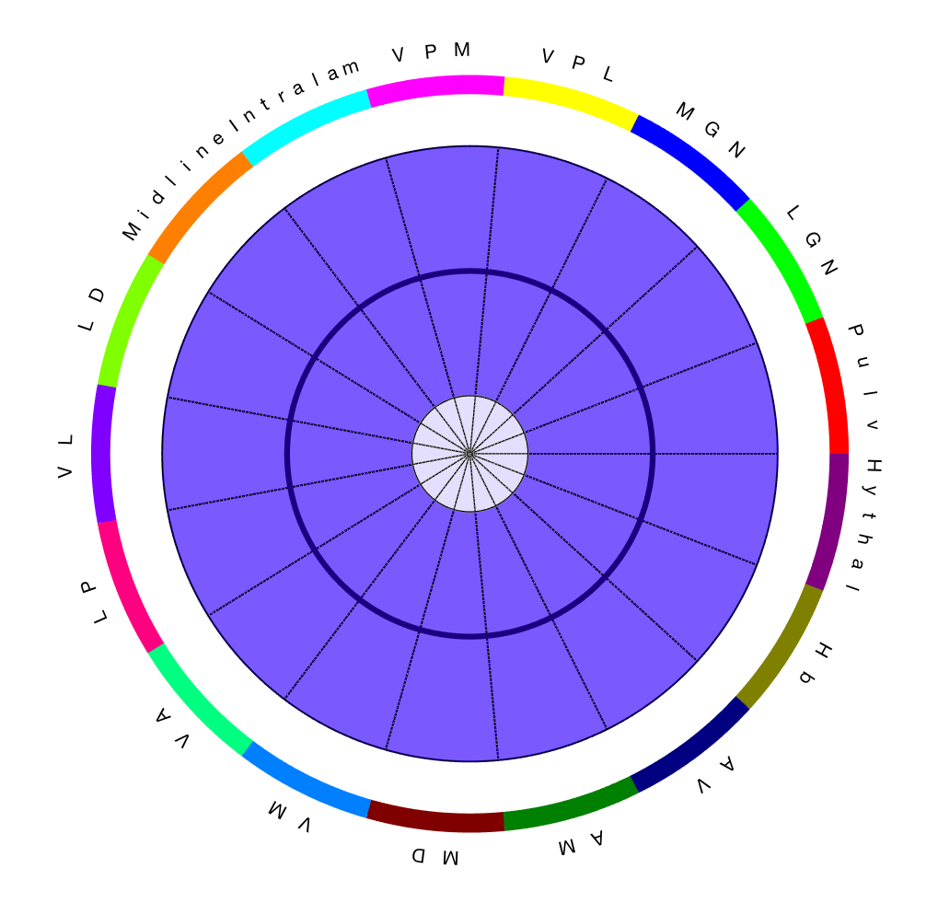
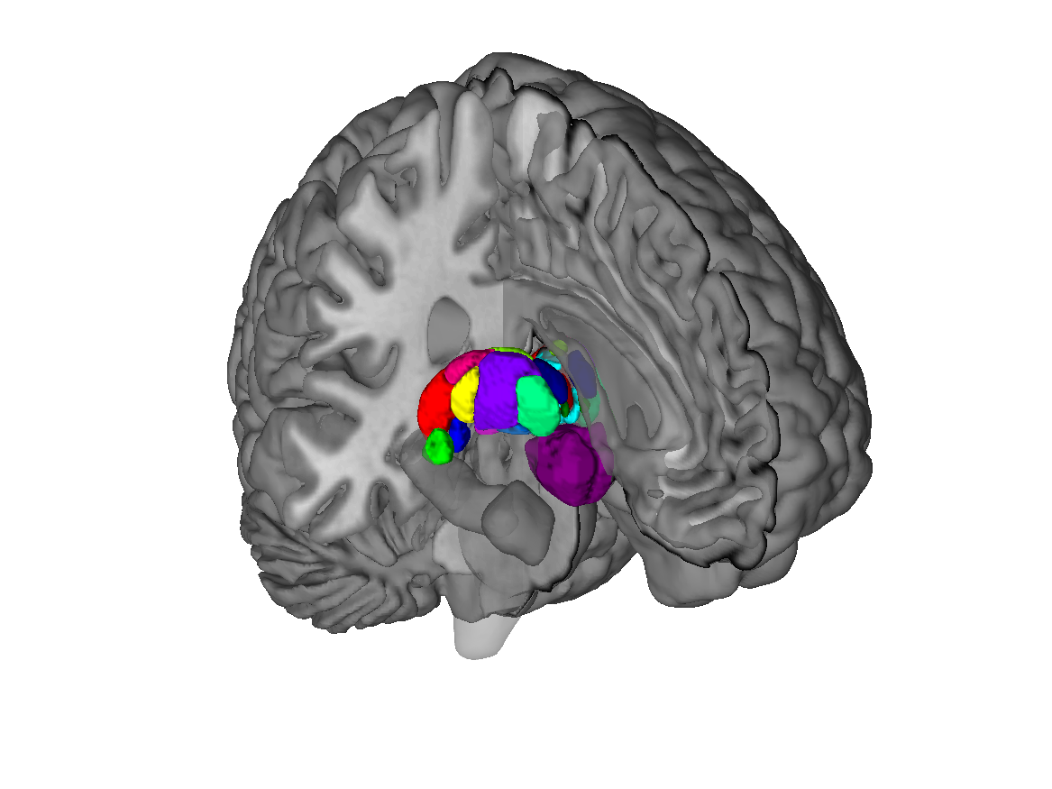
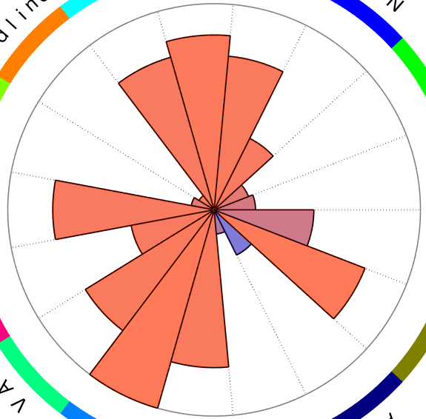
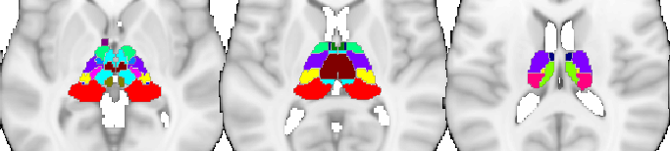
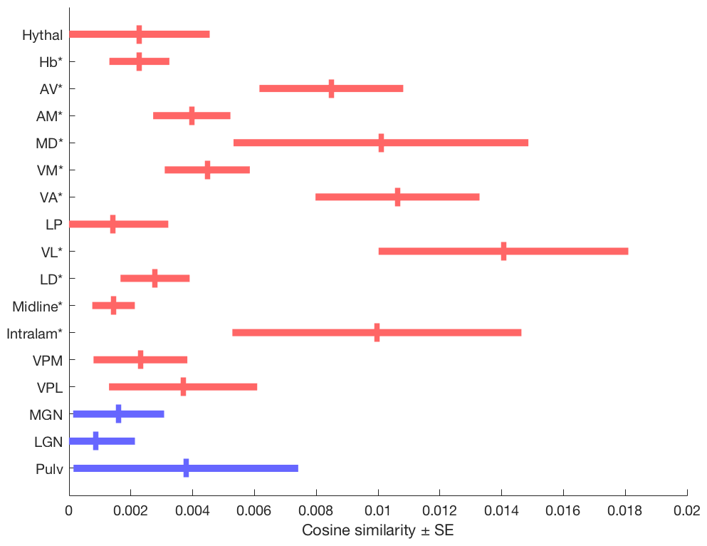
B
Thalamic regions
Thalamic regions
Thalamus

Slide 7
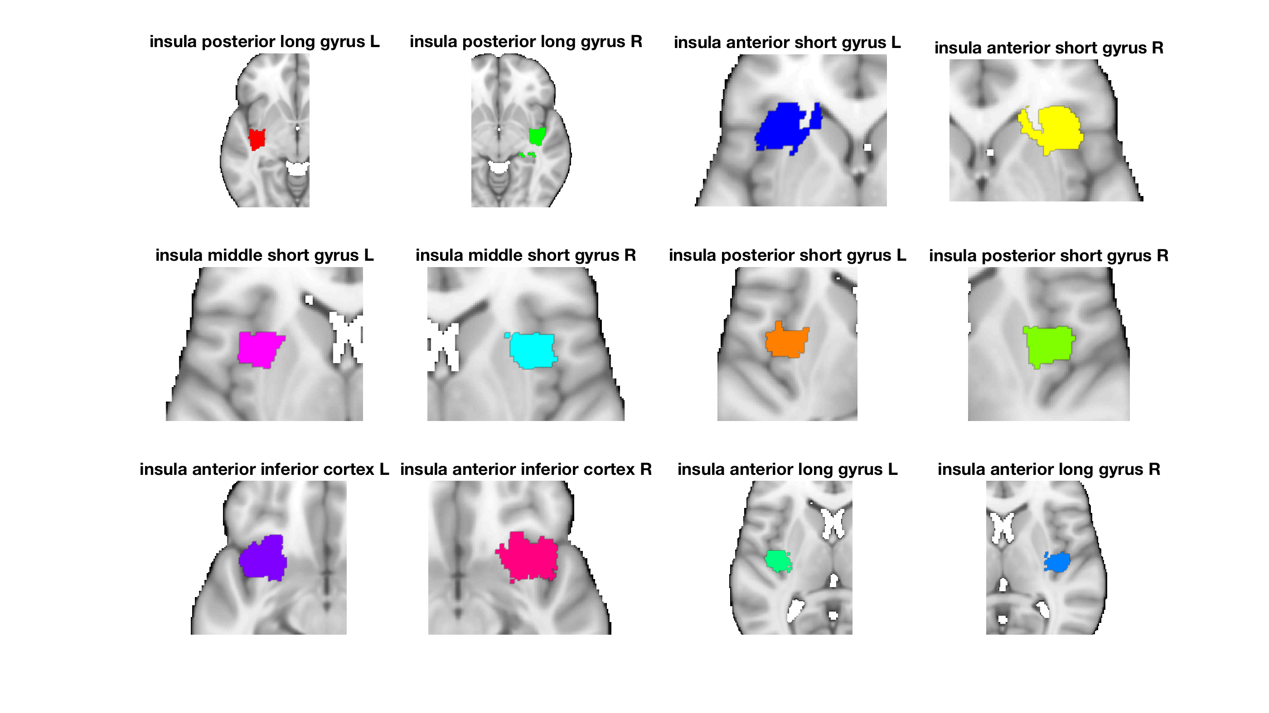
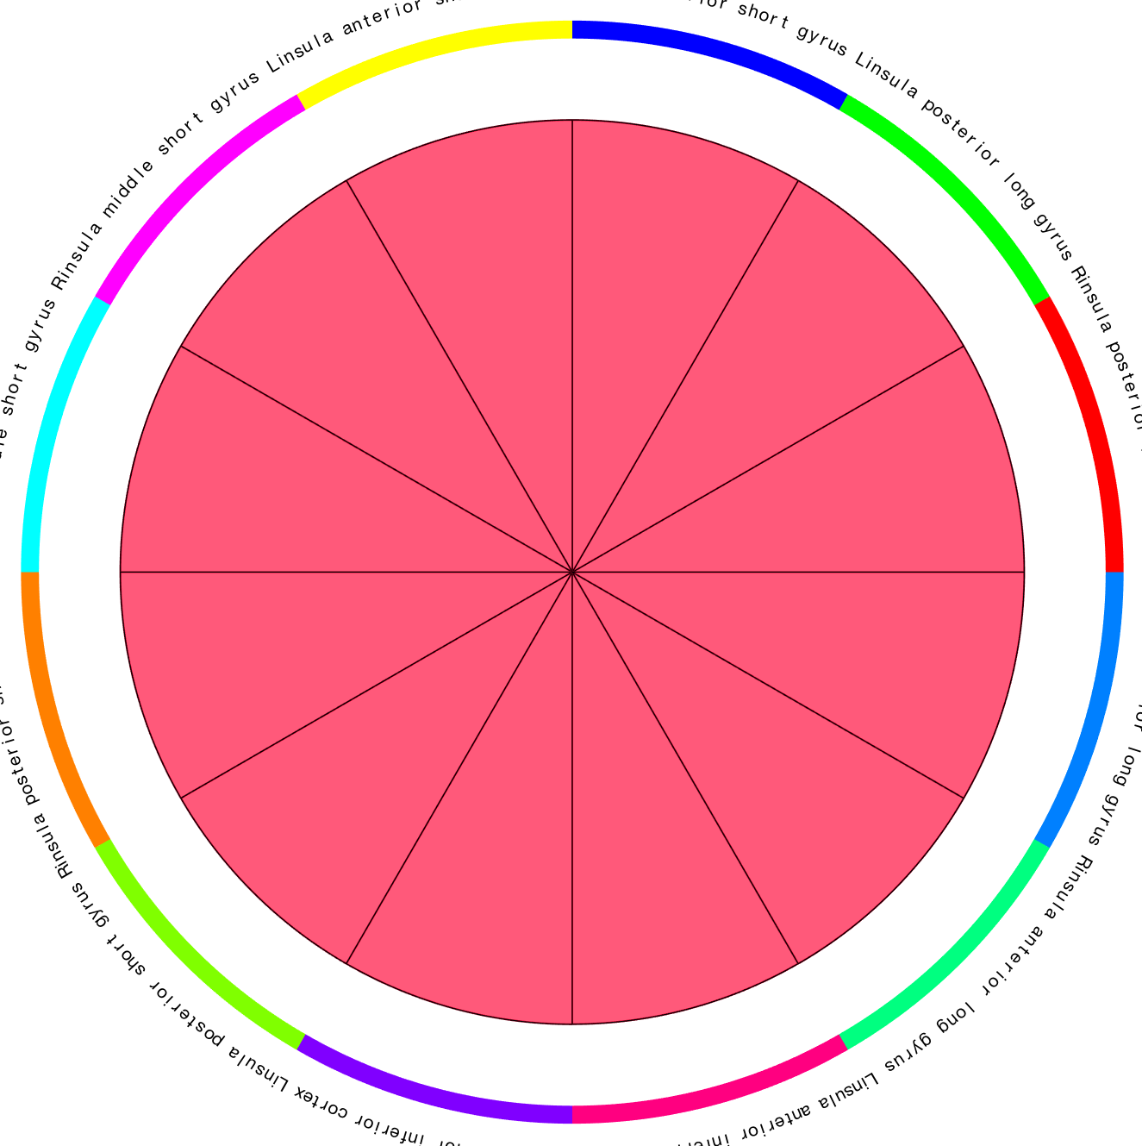
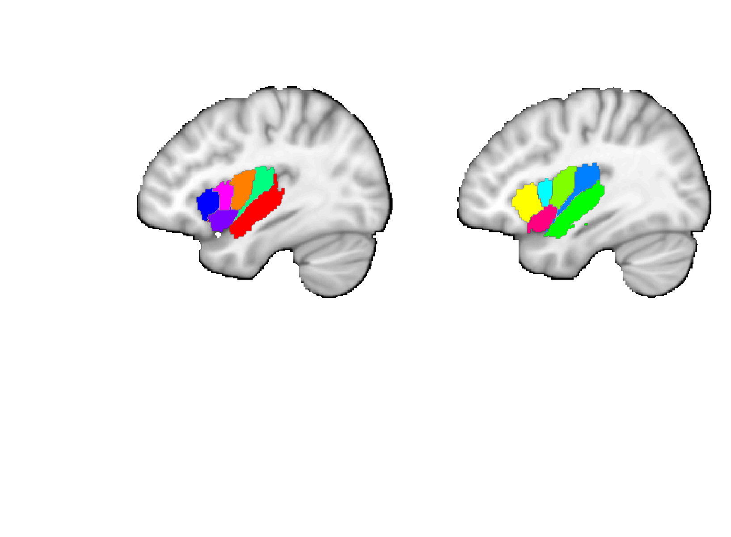
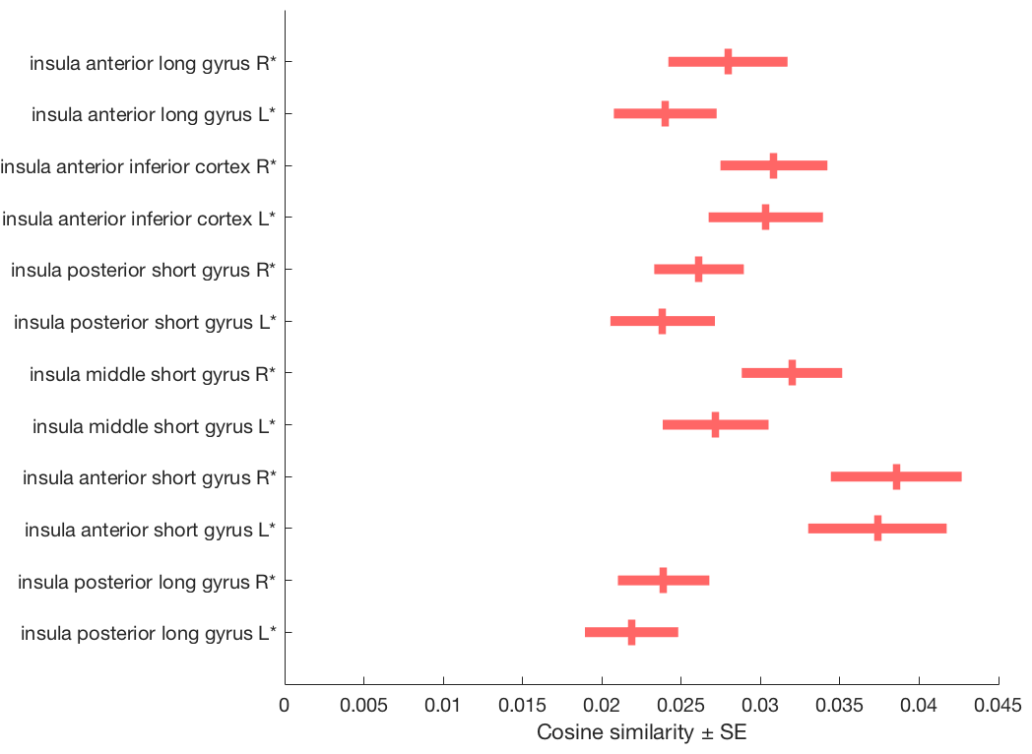
Faillenot insula
Post. short
Ant. long
Short
Long
Post.
Ant.
Middle short
Post. long
Mid.
Post.
Ant. short
Ant.
Ant. inf.
L
Ant. inferior
R
L
R
Short
Long
Post.
Ant.
Mid.
Post.
Ant.
Insula
Ant. inf.

Slide 8
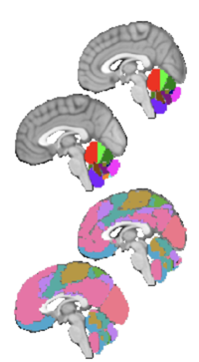
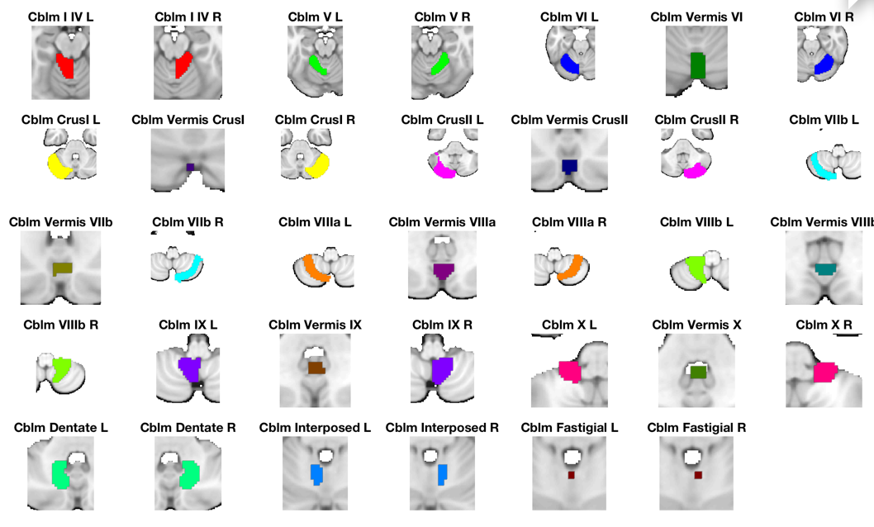
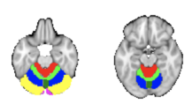
Diedrichsen Cerebellum
Diedrichsen, Jörn, Joshua H. Balsters, Jonathan Flavell, Emma Cussans, and Narender Ramnani. 2009. A Probabilistic MR Atlas of the Human Cerebellum. NeuroImage 46 (1): 39?46.’
Choi, Eun Young, B. T. Thomas Yeo, and Randy L. Buckner. 2012. “The Organization of the Human Striatum Estimated by Intrinsic Functional Connectivity.” Journal of Neurophysiology 108 (8): 2242–63.
Buckner, Randy L. 2013. “The Cerebellum and Cognitive Function: 25 Years of Insight from Anatomy and Neuroimaging.” Neuron 80 (3): 807–15.

Slide 9
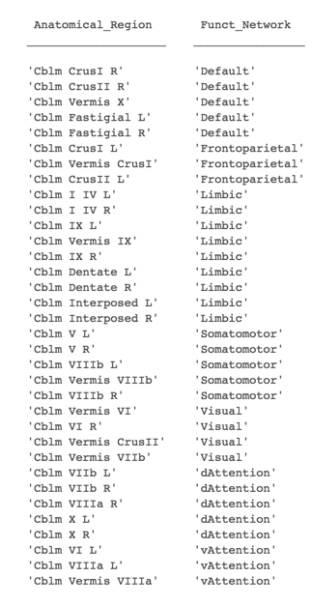
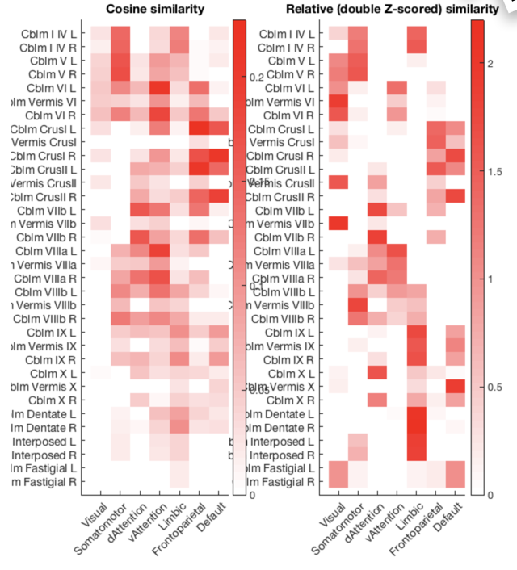
Cerebellum
Buckner/Yeo

